Slide 1
PRESENTATION FOR TFS KOLKATA

Slide 2
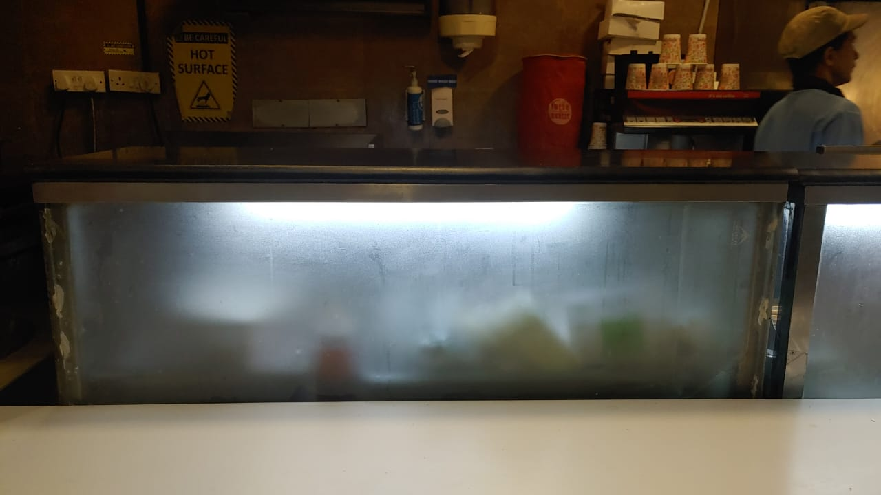
KAILASH PARVAT (FOOD TERMINAL)
W-47 X H-13 INCH
MATERIALS SPECIFICATION
VINYL PRINTING & PESTING

Slide 3
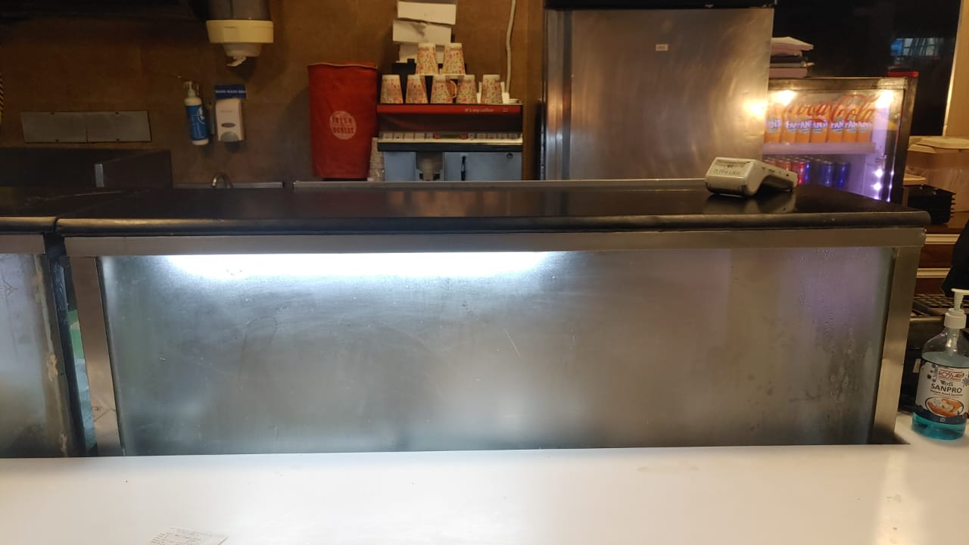
KAILASH PARVAT (FOOD TERMINAL)
W-41 X H-13 INCH
MATERIALS SPECIFICATION
VINYL PRINTING & PESTING

Slide 4
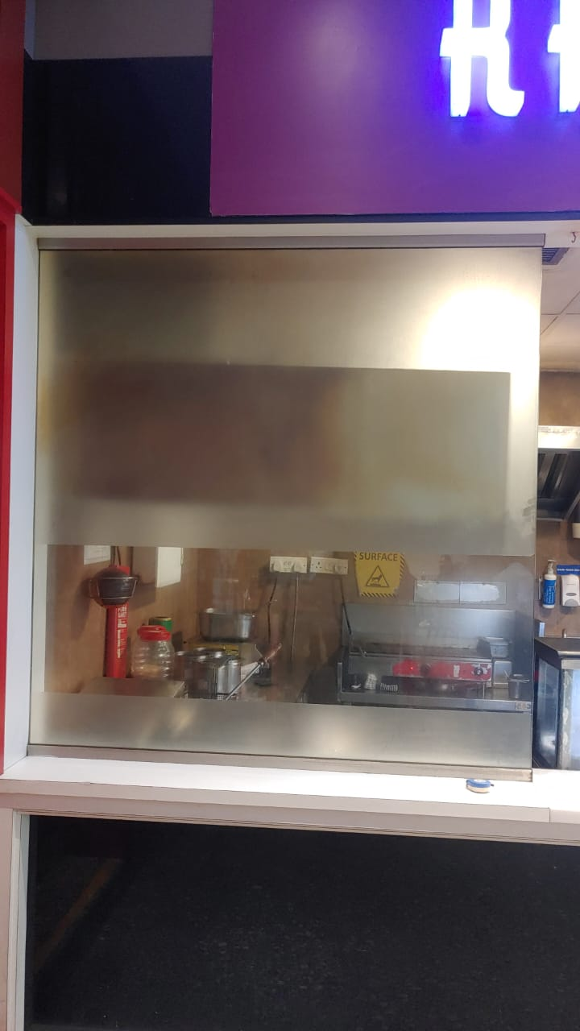
KAILASH PARVAT (FOOD TERMINAL)
W-60 X H-57 INCH
MATERIALS SPECIFICATION
VINYL PRINTING & PESTING

Slide 5
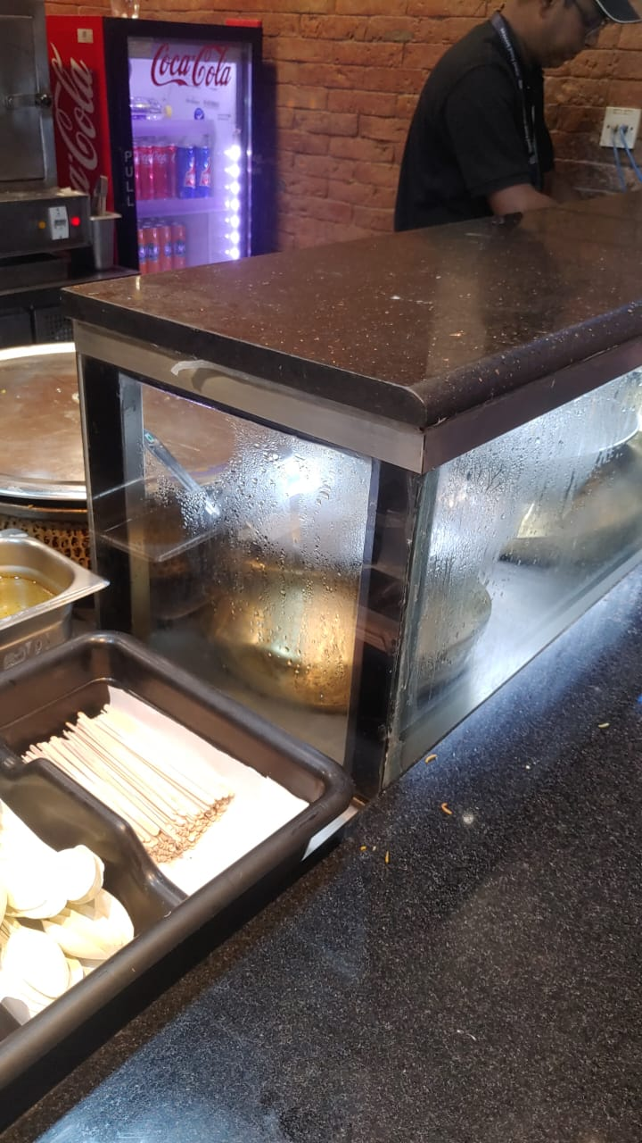
KOLKATA STREET (FOOD TERMINAL)
W-14 X H-12 INCH
MATERIALS SPECIFICATION
VINYL PRINTING & PESTING

Slide 6
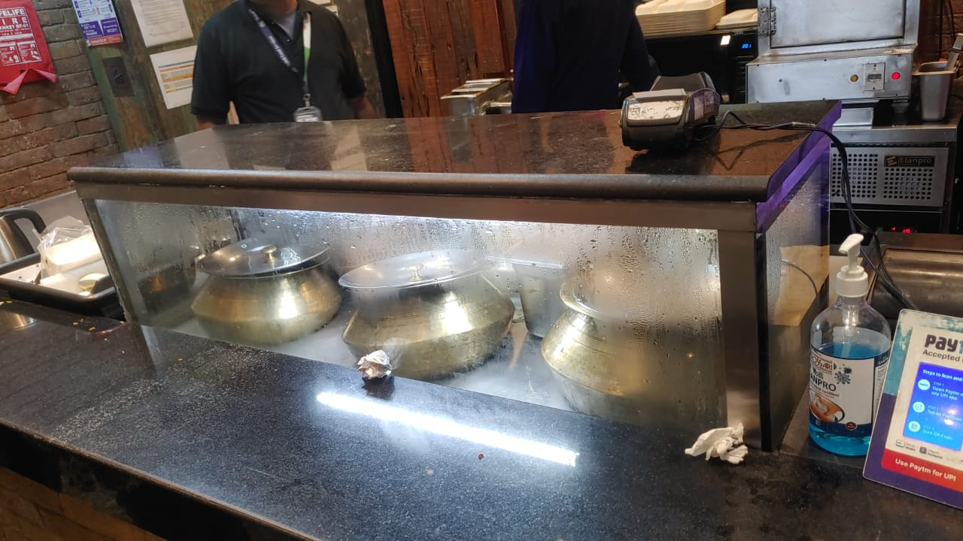
KOLKATA STREET (FOOD TERMINAL)
W-47 X H-10 INCH
MATERIALS SPECIFICATION
VINYL PRINTING & PESTING

Slide 7
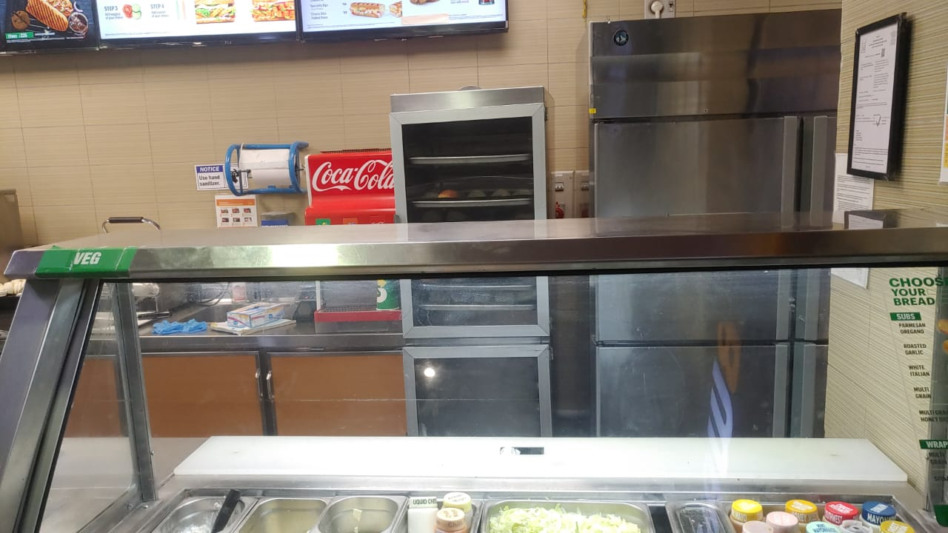
SUBWAY (FOOD TERMINAL)
W-61 X H-2 INCH
MATERIALS SPECIFICATION
VINYL PRINTING & PESTING

